Slide 1
Score functions

Slide 2

Rosetta energy function – ref2015
Link: https://doi.org/10.1021/acs.jctc.7b00125
This paper describes the ref2015 score function, the default used today
If you find yourself with free time today you might want to check this out

Slide 3
What drives Rosetta?

Slide 4
Levinthal’s Paradox - You cannot brute force folding
Most small proteins fold spontaneously on a millisecond or even microsecond time scale, even though there is a massive conformational space.
How many possible configurations are there for the typical 300-residue protein?
How do you traverse the sample space?
Protein folding is a problem for people not proteins?
This a classic joke, must be told every time the Levinthal Paradox is mentioned

Slide 5
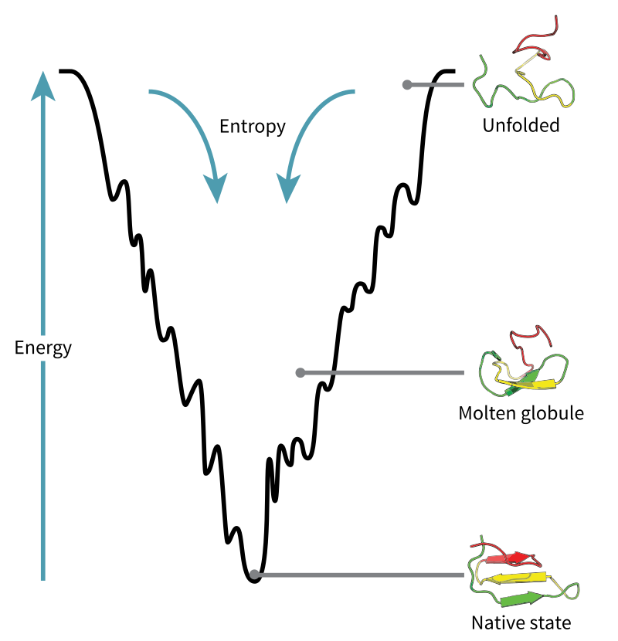
Anfinsen’s Dogma - Native is lowest-energy state
Structure determined only by sequence
The native structure is a unique, stable and kinetically accessible minimum of the free energy
What are some exceptions?
Notes:
Unique – sequence does not have any other configuration with a comparable free energy. Hence the free energy minimum must be unchallenged.
Stability – Small changes in the surrounding environment cannot give rise to changes in the minimum configuration. This can be pictured as a free energy surface that looks more like a funnel (with the native state in the bottom of it) rather than like a soup plate (with several closely related low-energy states); the free energy surface around the native state must be rather steep and high, in order to provide stability.
Kinetical accessibility – Means that the path in the free energy surface from the unfolded to the folded state must be reasonably smooth or, in other words, that the folding of the chain must not involve highly complex changes in the shape (like knots or other high order conformations).
Exceptions
PTMs, proteins sequence is changed
Charperones
Proteins that have multiple states

Slide 6
What is a score function for?

Slide 7
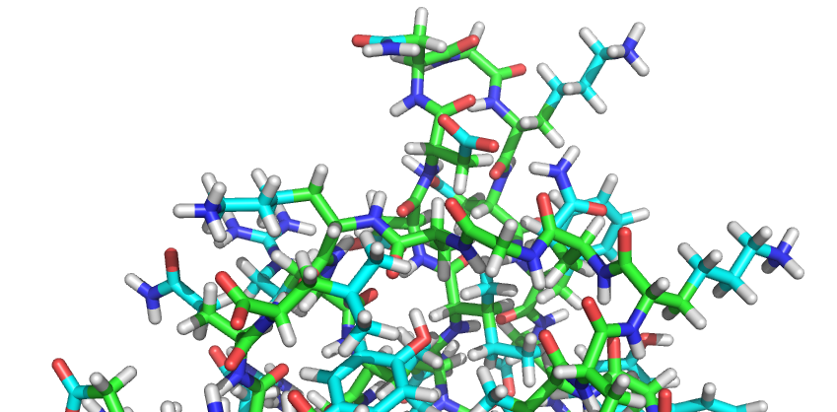
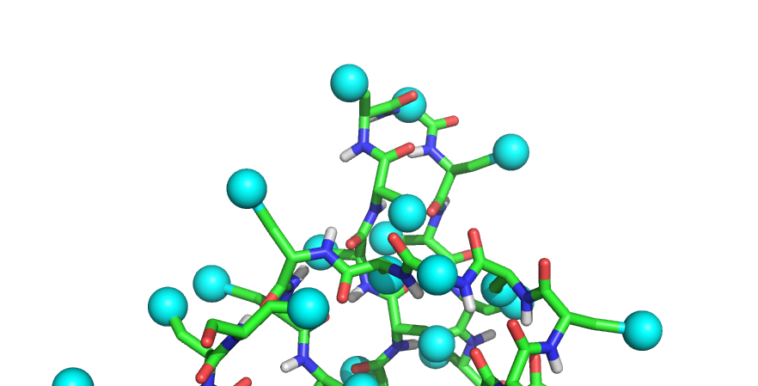
Two means of representing a pose
Full atom
Centroid
SwitchResidueTypeSetMover("fa_standard")
SwitchResidueTypeSetMover("centroid")
Why would you want two scoring functions?
Notes:
Why?
Faster, efficient
Lower resolution, easier to find a minimum
Early stages of folding, then switch to

Slide 8
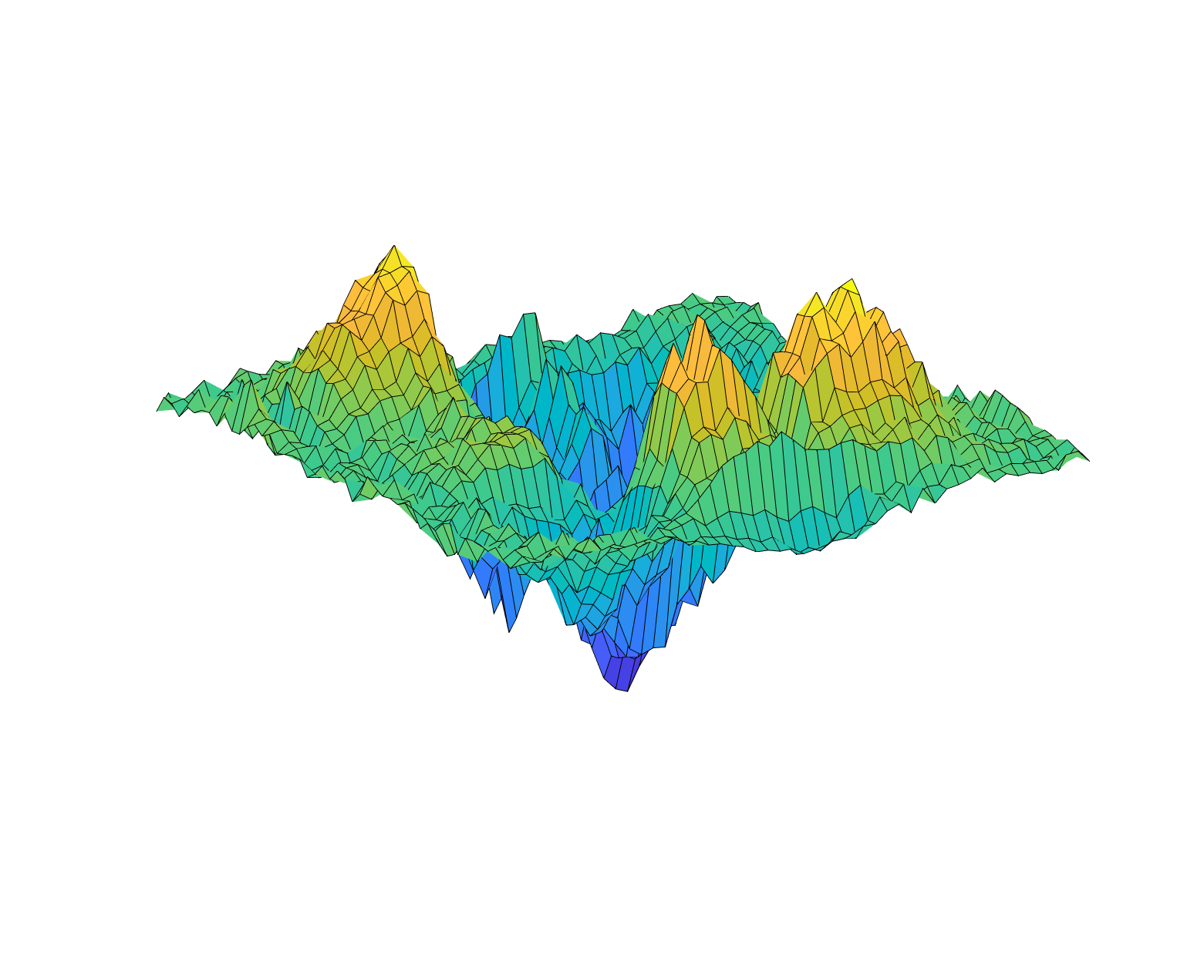
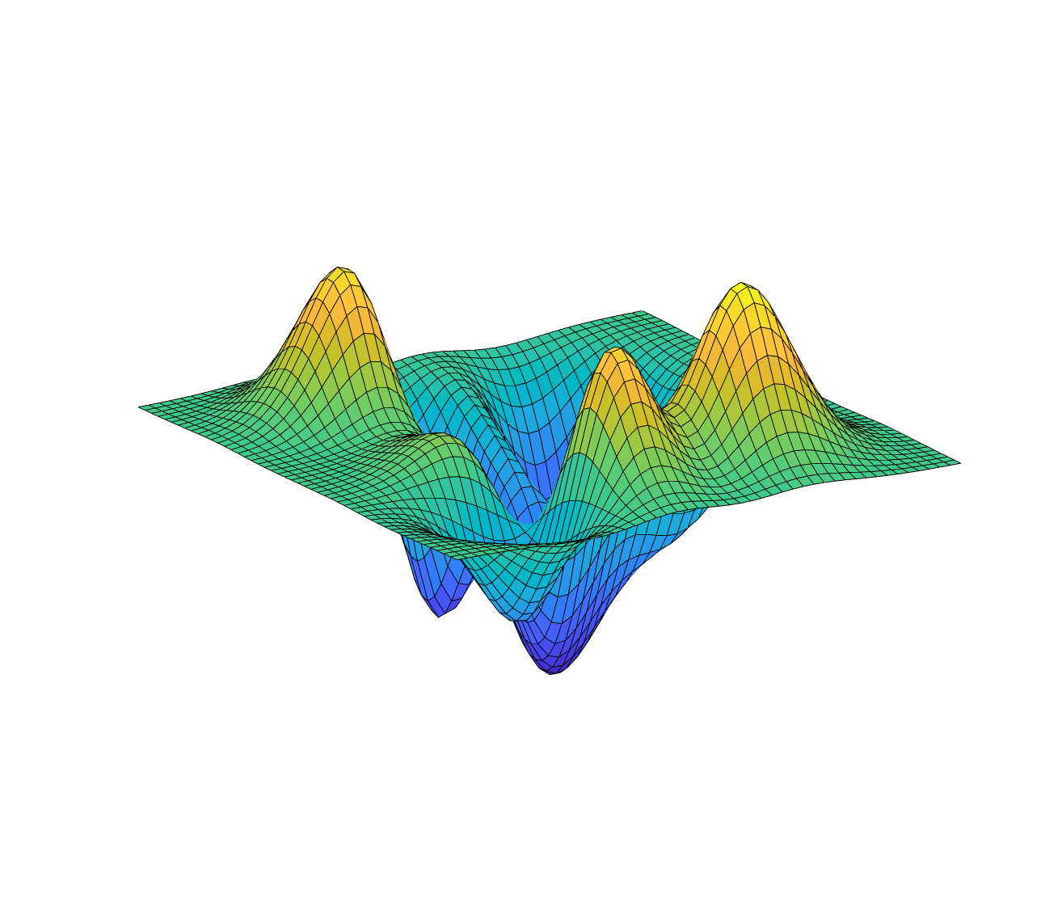
Centroid score functions have smooth landscapes
Ideal centroid energy landscape
Full atom energy landscape
Notes:
What are some things you notice about the energy landscape?
Smoother, Easier to traverse and find minimum
What needs to be true about this thi score function?
Differentiable at all places

Slide 9
The ref2015 score function

Slide 10
How do you find the energy of a protein?
Types of interactions considered:
Nonbonded atom pairs
Hydrogen and disulfide bonds
Backbone and sidechain torsions
Other features
Other environments
Add up the energies of each residue!
ΔEtotal is the linear combination of energy terms Ei for geometric degrees of freedom (Θ) and chemical identities (aa), scaled by weights (w)
Notes:
4 and 5 vary based on situation

Slide 11
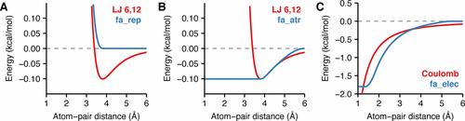
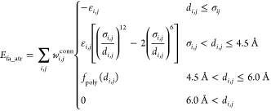
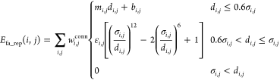
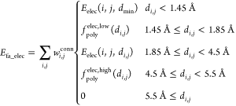
Van der Waals and electrostatics
Energy goes to zero at far enough distances
Notes:
Rosetta splits the LJ potential at the function’s minimum (di,j = σi,j) into two components that can be weighted separately: attractive (fa_atr) and repulsive (fa_rep). By decomposing the function this way, we can alter component weights without changing the minimum-energy distance or introducing any derivative discontinuities. Many conformational sampling protocols in Rosetta take advantage of this splitting by slowly increasing the weight of the repulsive component to traverse rugged energy landscapes and to prevent structures from unfolding during sampling.
Why split fa_rep/atr?
It allows you to weight them separately

Slide 12
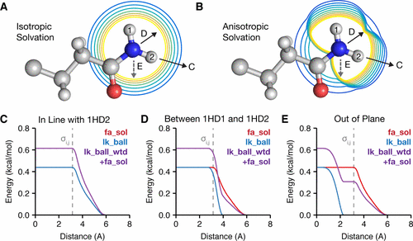
Solvation energy
Q: What is the most energy-intensive part of the protein to model?
Proteins bury hydrophobics and expose hydrophilics
Rosetta represents solvent as bulk water with the Lazaridis–Karplus (LK) implicit Gaussian exclusion
fa_sol: bulk water
lk_ball_wtd: water near polar atoms
Notes:
A: interactions with water
Modeling all those interactions is hard and slow
Described the desolvation energy, the energy required to squeeze water out of the way as two atoms approach each other
fa_sol, that assumes bulk water is uniformly distributed around the atoms
lk_ball_wtd, that accounts for specific waters nearby polar atoms that form the solvation shell
Isotropic: same in all directions
Anisotropic: vary depending on direction
Figure 2 shows comparisons of fa_sol, lk_ball (eq 17), and the sum of fa_sol and lk_ball_wtd for the example of an asparagine NH2 desolvated from three different approach angles. As the approach angle varies, the sum of lk_ball_wtd and fa_sol creates a larger desolvation penalty when water sites are occluded and a smaller penalty otherwise, relative to fa_sol alone.
2. Two-component Lazaridis–Karplus solvation model. Rosetta uses two energy terms to evaluate the desolvation of protein side chains: an isotropic term (fa_sol) and an anisotropic term (lk_ball_wtd). (A) and (B) demonstrate the difference between isotropic and anisotropic solvation of the NH2 group by CH3 on the asparagine side chain.

Slide 13
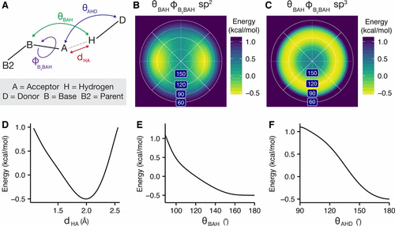
Hydrogen bonds
H-bonding has electrostatic and covalent components
Rosetta’s hydrogen-bonding model evaluates energies by comparing to bonds in 8000 crystal structures
D-F are examples of His-amide H-bonding energies
Notes:
Hydrogen bonds are partially covalent interactions that form when a nucleophilic heavy atom donates electron density to a polar hydrogen.(77) At short ranges (<2.5 Å), they exhibit geometries that maximize orbital overlap.(78) The interactions between hydrogen-bonding groups are also partially described by electrostatics.
(A) Degrees of freedom evaluated by the hydrogen-bonding term: the acceptor–donor distance, dHA; the angle between the base, acceptor, and hydrogen, θBAH; the angle between the acceptor, hydrogen, and donor, θAHD; and the dihedral angle corresponding to rotation around the base–acceptor bond, ϕB2BAH. (B) Lambert azimuthal projection of the EhbondB2BAH energy landscape for an sp2-hybridized acceptor.(49) (C) EhbondB2BAH energy landscape for an sp3-hybridized acceptor. (D–F) Example energies for hydrogen bonding of the histidine imidazole ring acceptor with a protein backbone amide: (D) energy EhbondHA vs the acceptor–donor distance dHA; (E) energy EhbondBAH vs the base–acceptor–hydrogen angle θBAH; (F) energy EhbondAHD vs the acceptor–hydrogen–donor angle θAHD.

Slide 14
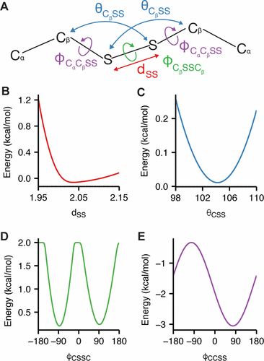

Disulfide bonds
Disulfides require a map that explicitly models the bonds, so there’s more degrees of freedom
Rosetta uses an orientation-dependent model to calculate covalently bonded cysteine pairs
Dslf_fa13 takes into account sulfur-sulfur distances, S-S bond angles, dihedrals
Notes:
However, with disulfide bonds and proline (discussed below), the extra bonds cannot be represented with a tree (since a tree graph is acyclic) and thus must be treated explicitly.
Orientation-dependent disulfide bonding model. (A) Degrees of freedom evaluated by the disulfide bonding energy: the sulfur–sulfur distance, dSS; the angle formed by Cβ and the two sulfur atoms, θCβSS; the dihedral angle corresponding to rotation about the Cβ–sulfur bond, ϕCαCβSS; and the dihedral angle corresponding to rotation about the S–S bond, ϕCβSSCβ. (B–E) Plots of the energy terms (B) EdslfSS(dSS), (C) EdslfCSS(θCβSS), (D) EdslfCβSSCβ(ϕCβSSCβ), and (E) EdslfCαCβSS(ϕCαCβSS)

Slide 15
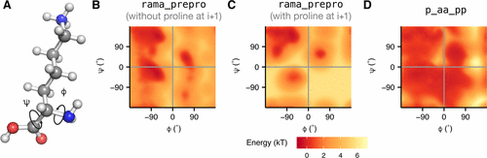


Ramachandran-based backbone scoring
Determining energies of backbone ϕ and ψ angles using 4000 Ramachandran maps, then evaluated using bicubic interpolation
rama_prepro
Bayesian probability of conformation, given existing backbone
p_aa_pp
Notes:
In pose lab, you explored phi and psi angles, who can tell me what they are and what you learned?
The terms we’ve been talking about so far have been evaluated between pairs of atoms, but we also need to evaluate the internal energies of residues side chains and backbones
Figure 5. Backbone torsion energies. (A) The angle ϕ is defined by the backbone atoms Ci–1–N–Cα–C, and the angle ψ is defined by N–Cα–C–Ni+1. (B, C) Backbone-dependent torsion energies (Erama_prepro) for the lysine residue (B) without a proline at i + 1 and (C) with a proline at i + 1. (D) Ep_aa_pp of lysine.

Slide 16
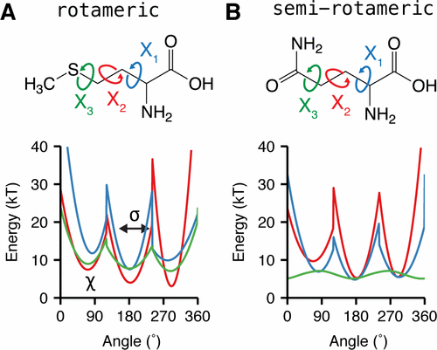
Sidechain Conformations
Sidechains mostly are in discrete rotamers, which each have an associated probability
Sp3 and sp2 hybridization determines if aa has rotamers
Similar probability distribution is used to determine scores for sidechains
Notes:
3 main angles
(1) observing a specific rotamer given the backbone dihedral angles; (2) observing specific χ angles given the rotamer; and (3) observing the terminal χ angle distribution, which is either Gaussian-like or continuous when the terminal χ angle is sp2-hybridized

Slide 17
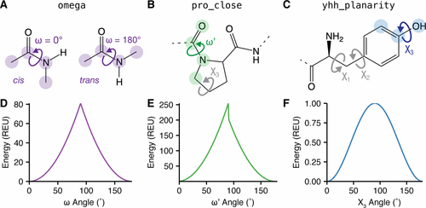
Special case side chains
Certain residues require more parameters
Notes:
A–C) Rosetta implements three additional energy terms to model torsional degrees of freedom with acute preferences: (A) omega torsion, corresponding to rotation about C–N; (B) proline secondary omega torsion, corresponding to rotation about C–N related to the Cδ in the ring; (C) tyrosine terminal χ torsion. (D) Omega energy. (E) Proline closure energy. (F) Tyrosine planarity energy, hydroxyl hydrogen prefers to be in the plane of the aromatic ring..

Slide 18
Different score functions
Score functions can contain different weights or different parameters to look at different tasks
Including other biomolecules (carbohydrates, DNA/RNA)
Modeling in non-aqueous environments (membrane)
Modeling extreme pHs
Docking has a different weight patch
Symmetric proteins need to account for symmetry
And more!

Slide 19
Extra notes
Scorefunction calculates in Rosetta Energy Units, which have no real meaning
Ref2015 has been calibrated to be roughly equivalent to kcal/mole
Scores are calculated per-residue
That means you can’t compare scores between entirely different proteins
Scoring is essential to many protocols
You must score your pose or your protocol will fail

